Slide 1
Flash Matting
Team FFT :
Aryan Kharbanda (2019101018) Kushal Kumar Jain (2019111001)
Pranav Kannan (2019111033) Tathagato Roy(2019111020)
Mentor : Haripraveen Subramanian
Paper Name : Flash Matting
Authors : Jian Sun et al

Slide 2
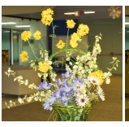
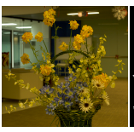
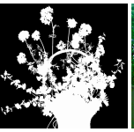
Problem Statements
Extracting Foreground Objects and Alpha Matte from an Image
Similarity between Background and Foreground makes it a challenging task.
We utilise a pair of flash and no flash image to tackle this challenge.

Slide 3
Motivation
Extracting the foreground objects have various applications especially in digital media creation
Primary Method use Chroma Keying (Green /Blue screen)
Requires extremely well conditioned studio environment
Other methods require human inputs in the loop
More Art than Science

Slide 4
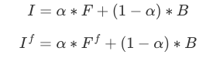
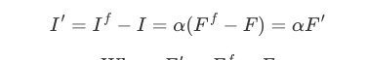
Main Idea
We utilise a pair of Flash and no Flash Image of the object to generate mattes of the foreground
The assumption is that in images where the background is farther behind the foreground ,the flash will only brighten the foreground object

Slide 5
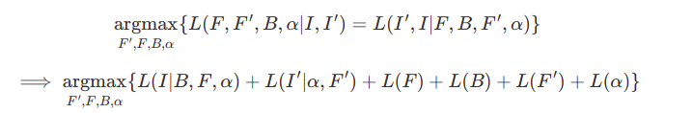
Joint Bayesian Formulation
Given that we have observed a pair of Image F and F’ we want to estimate F,B ,F’ and alpha
We do that using Bayesian Frame Work Where we maximise a Log Likelyhood.
Given a trimap which separates the image into 3 regions : Surely Foreground,Surely Background and Unknown.For every unknown pixel in the image, we solve the following optimisation problem

Slide 6
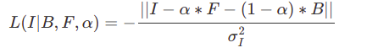
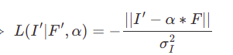
Joint Bayesian Formulation
We use a Gaussian to model the first two terms of the previous equation.
It measures the fitness of the solved Variables with respect to the Matte Equations

Slide 7
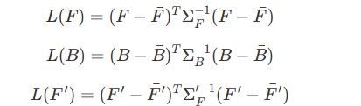
Joint Bayesian Formulation
The terms related to the Foreground pixels, Background Pixels, and Flash Only pixels are computed by using the statistics of the known pixels in a given neighbourhood.
Pixels in the neighbourhood are clustered using Kmeans and Mean and Covariances are computed for each cluster.
Then the Log terms are computed using following equations.

Slide 8
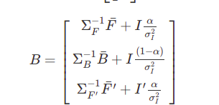
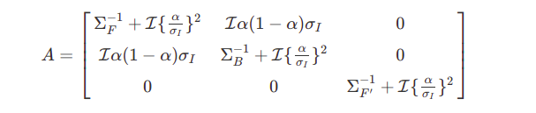
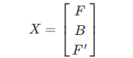
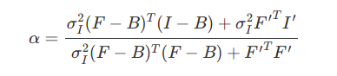
Joint Bayesian Formula
We solve the above likelihood Equation by differentiating the Equation with respect to F and B and F’ and setting it to zero
We get the system of Equations of the form : AX + B

Slide 9
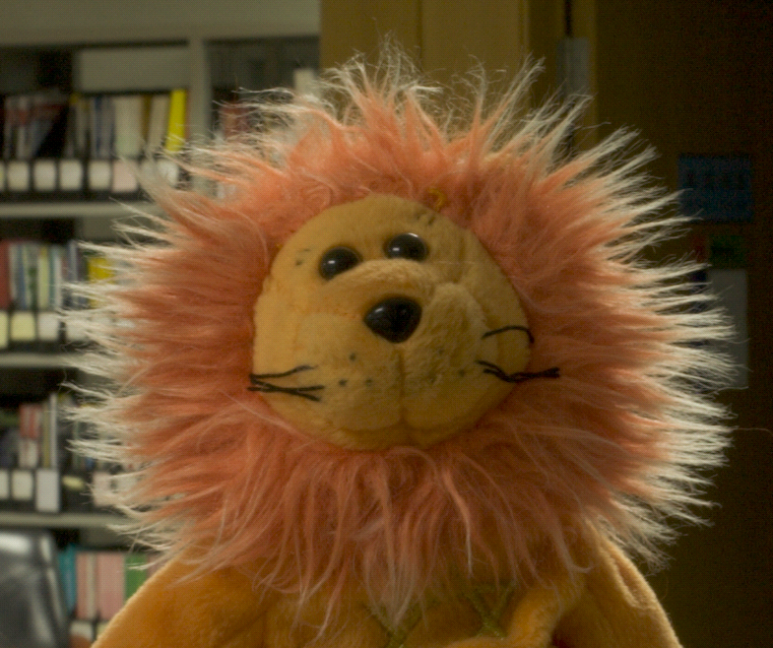

Trimap Generation
Trimap is type of image segmentation.
It partitions the image into three regions: a definite
foreground, a definite background, and a blended region where pixels are ambiguous and it is hard to label them as foreground or background.
Matting problem is basically to minimize the ambiguous region to 0 pixels.

Slide 10
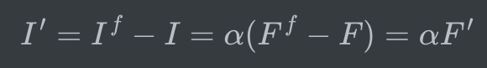
Trimap Generation
We estimate the trimap from I′
a global high threshold T is used to detect a foreground region with high confidence.
We set T as the first local minimum of the histogram (128 bins) of
the intensity of I′
A lower threshold of 0.5T is used to detect foreground regions with lower confidence.
The histogram is smoothed using a Gaussian kernel (with a sigma of 5) to reduce noise.

Slide 11
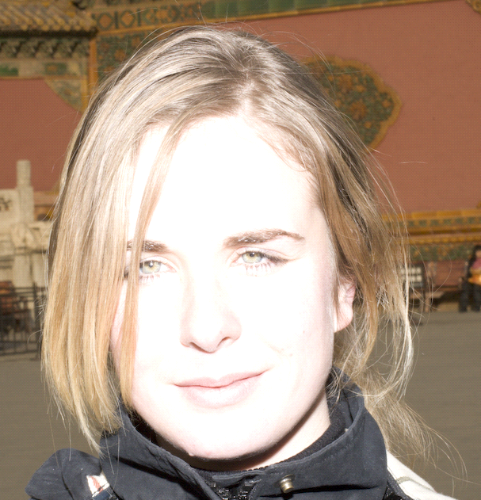

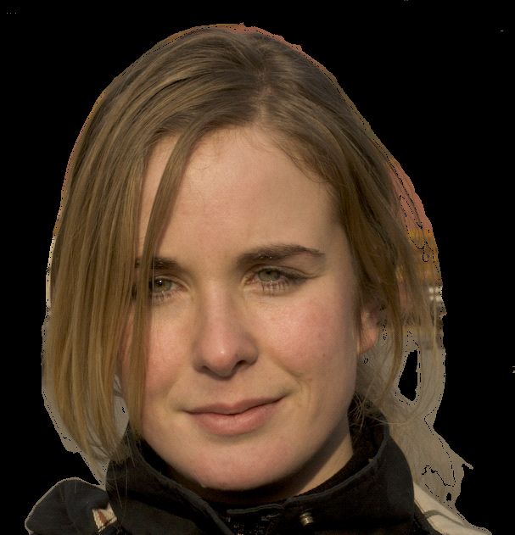
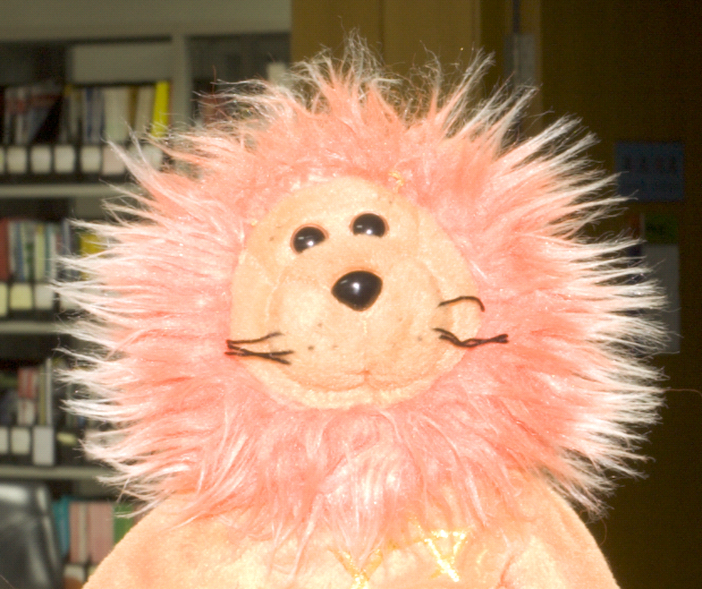
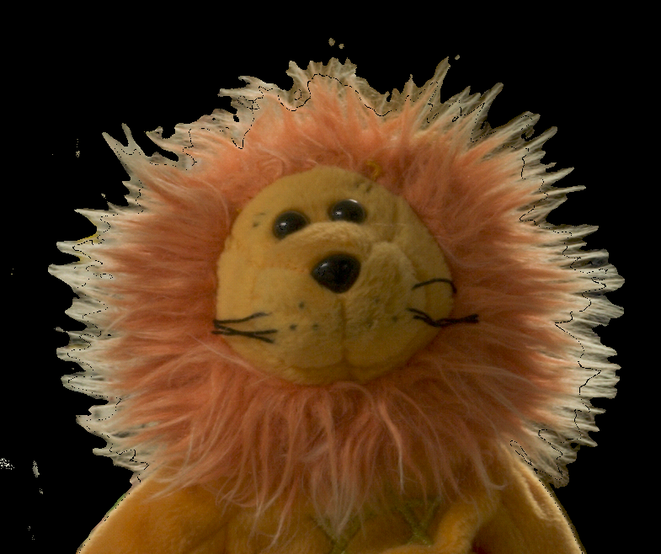
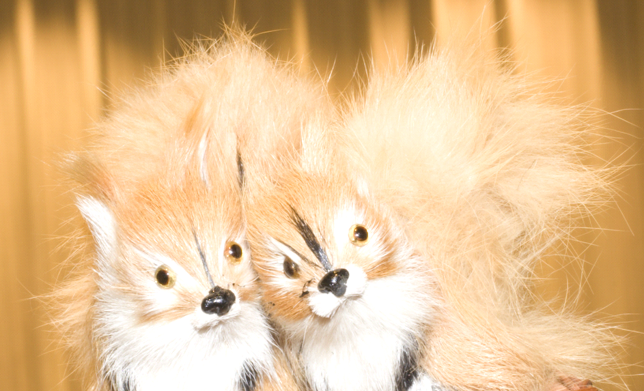
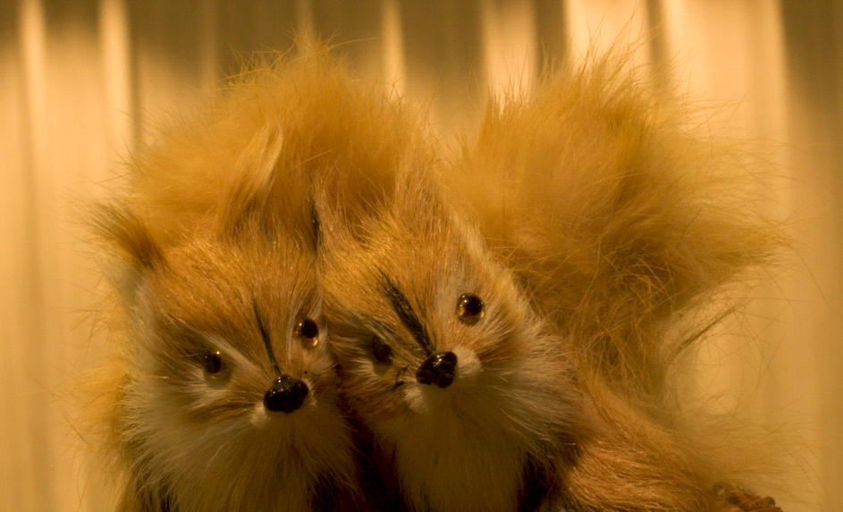
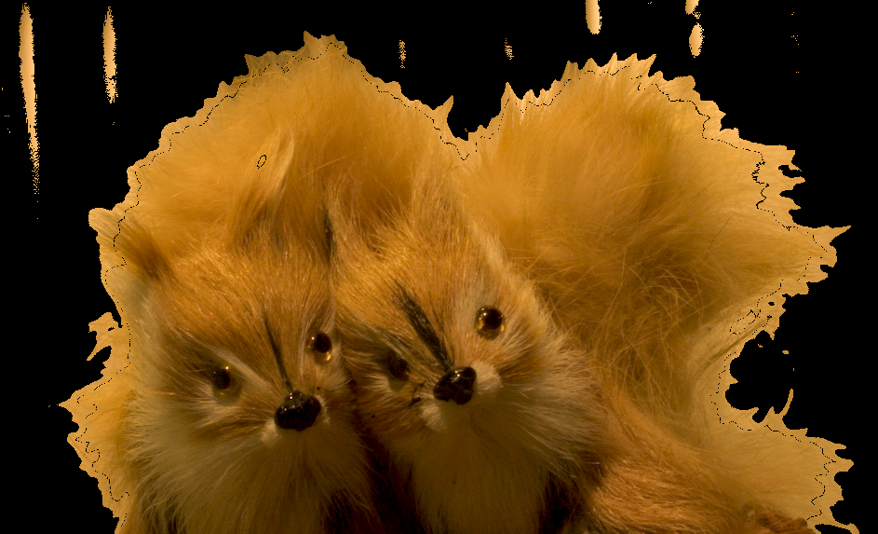
Results

Slide 12
Work Distribution
Joint Bayesian Matting : Tathagato and Kushal
Bayesian Matting :Tathagato and Aryan Kharbanda
Trimap Creation : Kushal and Pranav
UI : Aryan Kharbanda

Slide 13
References
[1] Sun, J., Li, Y., Kang, S. B., & Shum, H.-Y. (2006). Flash matting. In ACM Transactions on Graphics (Vol. 25, Issue 3, pp. 772–778). Association for Computing Machinery (ACM).
[2] Yung-Yu Chuang, Brian Curless, David H. Salesin, and Richard Szeliski. A Bayesian Approach to Digital Matting. In _Proceedings of IEEE Computer Vision and Pattern Recognition (CVPR 2001)_, Vol. II, 264-271, December 2001
[3] Venkatesh Praveen , Bayesian-Matting , (2021), GitHub repository https://github.com/praveenVnktsh/Bayesian-Matting
[4] Ya\ug\iz Aksoy, Changil Kim, Petr Kellnhofer, Sylvain Paris, Mohamed Elgharib, Marc Pollefeys, & Wojciech Matusik (2018). A Dataset of Flash and Ambient Illumination Pairs from the Crowd. In Proc. ECCV.

